Slide 1

San Antonio Pet Adoption

Slide 2

Research Questions
For the purposes of this project, we looked for demographic information related to adopted and adoptable dogs in shelters within a 150-mile radius of San Antonio, between January and November 2020. Specific research questions included:
How many animal shelters are within 150-mile radius of San Antonio?
How many dogs were in these shelters between January and November 2020?
Out of the total number of dogs, how many were adopted during this time? How many dogs are still adoptable as of November 2020?
For the total number of dogs and adopted/adoptable comparisons in these shelters:
What were the top breeds represented?
What was the gender breakdown?
What were the sizes of these dogs?
What were the ages of these dogs?
What percentage of these dogs were vaccinated?
What percentage of these dogs were spayed/neutered?
Which shelter in the 150-mile radius has the most dogs?
How do the demographics of the largest shelter compare to the overall shelter population?

Slide 3
Overall Sample Information
Total Shelters Represented in the Sample 150-Mile Radius of San Antonio: 123
Total Number of Dogs in these shelters between January and November 2020: 7478
Total Adopted Dogs as of November 15, 2020: 5824
Total Adoptable Dogs as of November 15, 2020: 1654

Slide 4
Data
Petfinder
Directory of around 11,000 pet shelters and adoption organizations across the United States, Canada, and Mexico
Updated daily
API accessible databases
Petpy library for Python/Pandas
Kaggle
2018 Petfinder Dataset showing shelter names
Data Clean-Up
Data Analysis

Slide 5
Adopted vs. Adoptable Dogs

Slide 6
Top 5 Breeds
Adoptable Breeds
Labrador Retriever
Pit Bull Terrier
Shepherd
Terrier
American Staffordshire Terrier
Adopted Breeds
Labrador Retriever
Chihuahua
Terrier
Pit Bull Terrier
Dachshund

Slide 7
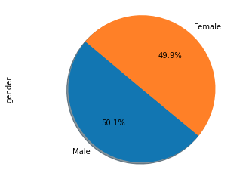
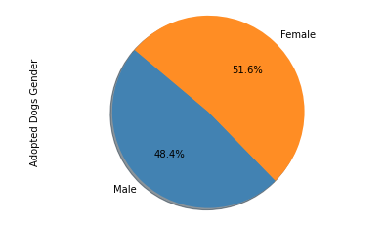
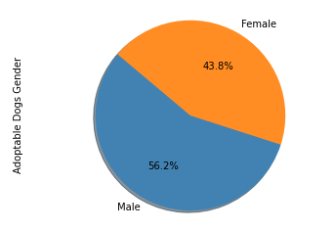
Gender
Total Sample (N= 7478)
Adoptable Sample
(n= 1654)
Adopted Sample
(n= 5824)

Slide 8
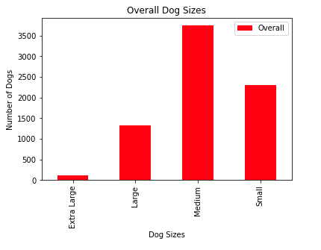
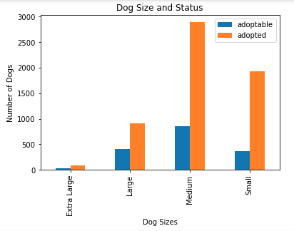
Dog Size

Slide 9
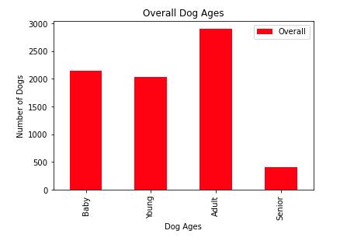
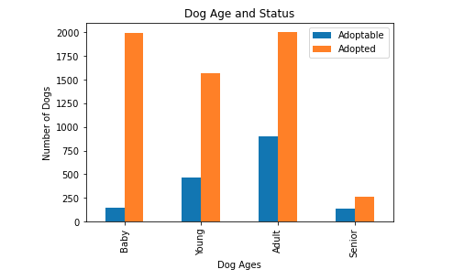
Dog Age and Status

Slide 10
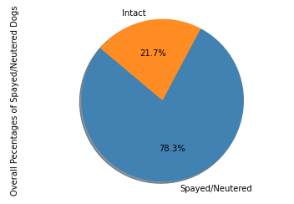
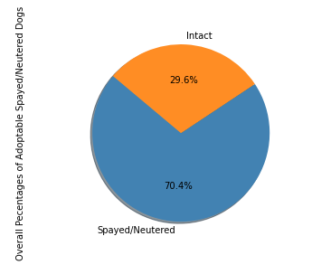
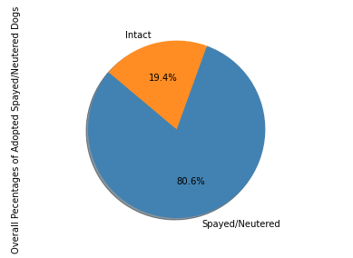
Percentages of Spayed/Neutered

Slide 11
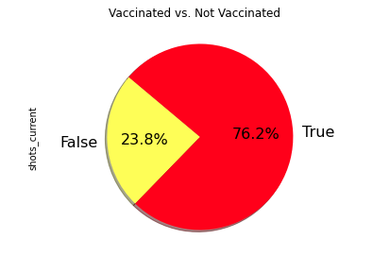
Vaccinated vs. Not Vaccinated
Vaccinated vs Not Vaccinated:
76.2% are Vaccinated
23.8% are NOT Vaccinated
*These figures are representing All the shelters within a 150 mile radius of San Antonio

Slide 12
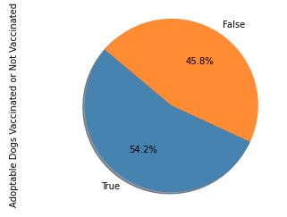
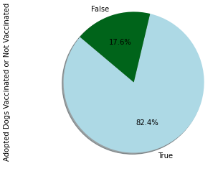
Compared: Adopted dogs that are Vaccinated or Not to Adoptable dogs that are Vaccinated or Not
*The above pie charts are a representation of overall adopted dogs that are vaccinated(left)
and the overall dogs that are adoptable and vaccinated (right) with in a 150 mile radius of San Antonio

Slide 13

An in-depth look at the largest shelter within a 150-mile radius of San Antonio.

Slide 14

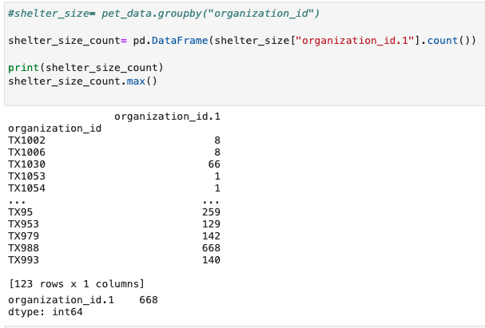
Upon a more in depth look at the larger shelters in the given radius, we concluded SNIPSA was the largest
SNIPSA Demographics
Total Number of Dogs: 668
Number of Unique Breeds: 60
Most Common Breed and Total: Chihuahua - 77

Slide 15
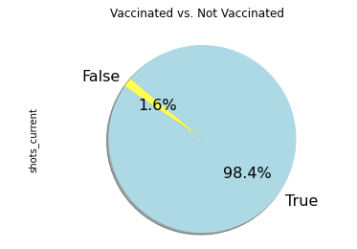
Vaccinated vs. Not Vaccinated
SNIPSA
SNIPSA shelter
vs
Overall Data

Slide 16
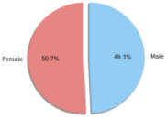
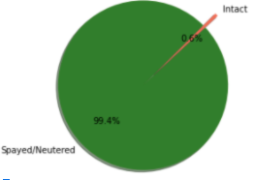
Gender and Spay/Neuter
SNIPSA
Overall Sample
SNIPSA
Overall Sample

Slide 17
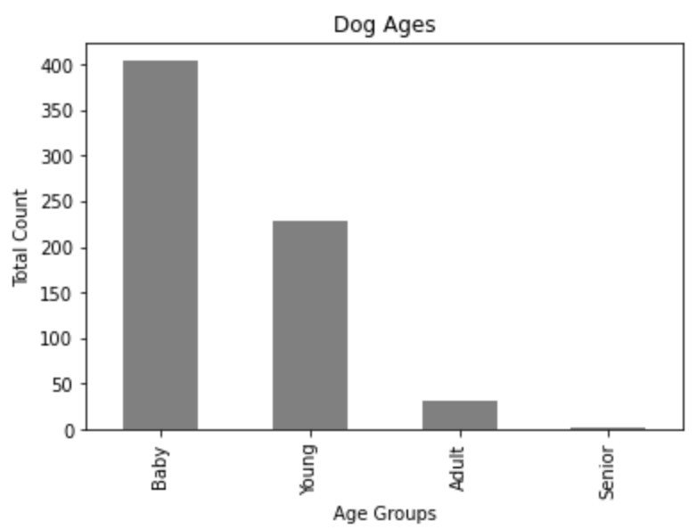
Dog Ages
SNIPSA
Overall Sample

Slide 18
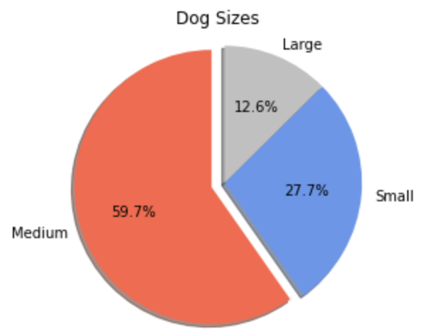
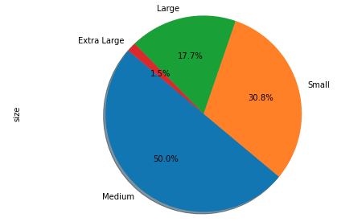
Dog Sizes
SNIPSA
Overall Sample

Slide 19
Conclusions

